Slide 1
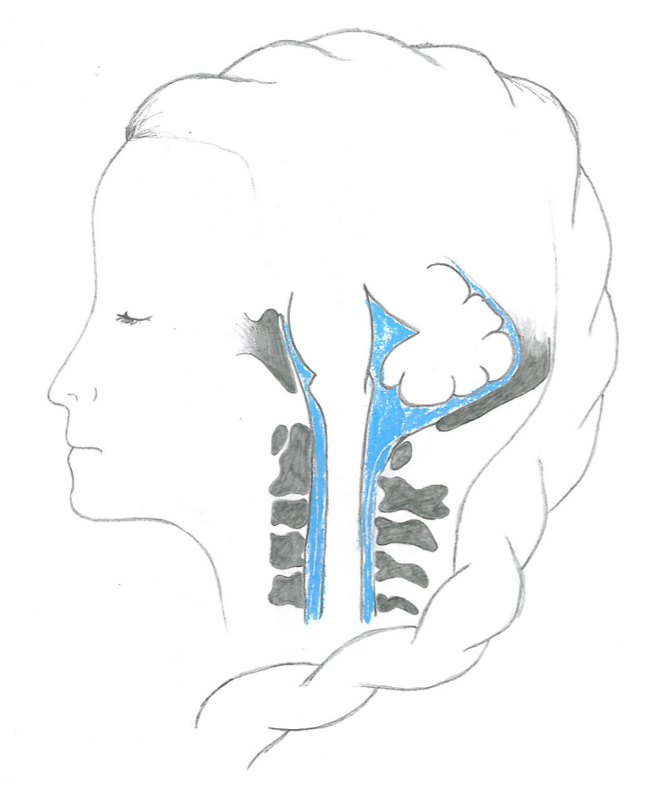
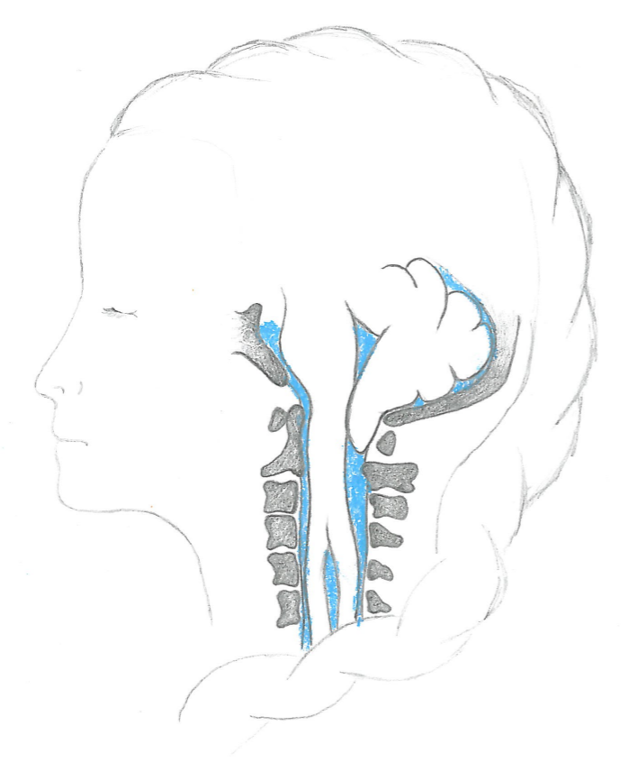
Chiari I is a medical condition where part of the brain is displaced into the spinal canal
Obstruction
Abnormal pressure and flow
Cyst formation
Notes:
Ok, but why are we interested in CSF flow in the spinal canal?
To the left you see the little brain and spinal cord in a healthy person. To the right you see a Chiari patient, where the cerebellum or little brain is displaced into the spinal canal and thus obstructing the blue CSF space. This abnormal anatomy disturbs the pulsatile flow and pressure environment and causes a wide range of symptoms such as severe head aches, sleep appnea and paralyses. Additionally, many Chiari patients develop fluid filled cysts within the spinal cord tissue (point).
The exact relation between Chiari I and spinal cord cyst is not known, but prevailing theories state that abnormal anatomy causes increased pressure gradients in the CSF space and that fluid flows from the CSF space into the tissue where it accumulates and eventually forms a cyst. It takes long for the cyst to form, so we look at small effects that adds up over time!
To treat these patients a decompression surgery is performed where parts of the bone is removed. This gives more space around the cerebellum and pain relief –moreover, the cysts often resolves.

Slide 2
A healthy person and a Chiari patient with syrinxes
Prevalence of Chiari ~ almost 1% according to some studies, but numbers
vary and the condition appears to be under-diagnosed

Slide 3
Chiari Symptoms
-Difficulty driving _ Difficulty negotiating steps,Pressure / pain in the neck _ Pressure / pain behind the eyes (soreness in the eyeballs) _ Back pain _ Neck spasms _ Insomnia _ Ringing in ears (like the tone heard in a hearing test) _ Swaying _ Pain when changing position _ Tingling / crawling feeling on scalp _ Intolerance to loud / confusing sounds _ Decreased sensitivity to temperature _ Pain & tension along ear / eye / jawline _ Difficulty swallowing / lump in throat / sore throat / swollen lymph nodes _ Drooling _ Spontaneous vertigo _ Hand tremors _ Poor blood circulation / cold hands & feet _ Sinus / mucous problems _ Sleep apnea _ Decreased muscle tone _ Pressure in ears / ears feel stopped up _ Nausea _ Difficulty reading / focusing on text _ Depth perception problems _ Burning sensation in extremities / shoulder blades _ Menstrual problems / severe cramping during period _ Fluid-like sound in ears (like water running) _ Loss of sexual interest / lack of sensation in pelvic area _ Pulling sensation while sitting / standing _ Intense itchiness w/profuse sweating _ Slurred speech _ Gag reflex problems / lack of gag reflex _ Pressure / tightness in chest _ Loss of bladder control _ Frequent urination _ Dehydration / excessive thirst _ Electric like burning sensations _ Unequal pupil size _ Loss of taste _ Popping / cracking sounds in neck or upper back when stretching _ Dizziness _ Loss of smell / problems with sense of smell _ Dry skin and lips _ Sudden / abrupt changes in blood pressure due to awkward position of head _ Hiccups associated with drinking carbonated beverages _ Skin problems Other: migraines, oscillopsia, lump in throat, colour blindness, albinism, visual floaters, astigmatism, thinning hair, hear heartbeat in ears, throat closes when lying flat, vomit in sleep, swollen face, low body temperature, low blood pressure, legs feel heavy, "strangling" feeling, "floating" sensation, thickening of finger joints.
Headache (esp. if daily or at lower back of head)
Painful tension in neck
Fatigue
Migraines
Dizziness
Visual disturbances / loss of vision / spots in vision / double vision / seeing spots or "halos" / nystagmus
Tingling / numbness in the extremities
General imbalance / clumsiness
Memory loss
Restricted movement
Intolerance to bright light / difficulty adjusting to light change
Vertigo from position change or sudden standing
Poor / degraded motor skills
Sleep apnea

Slide 4

Cavalier King Charles Spaniel (about 50% have syringomyelia)

Slide 5
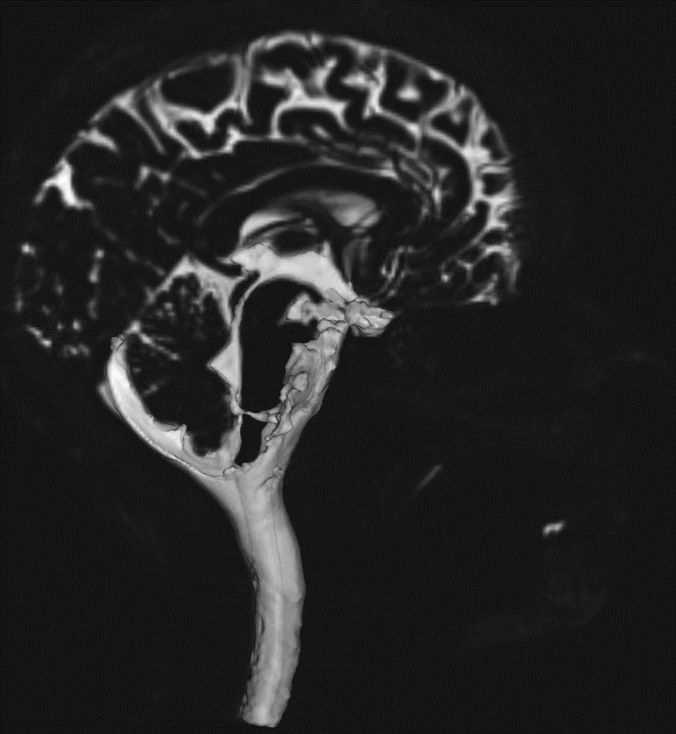
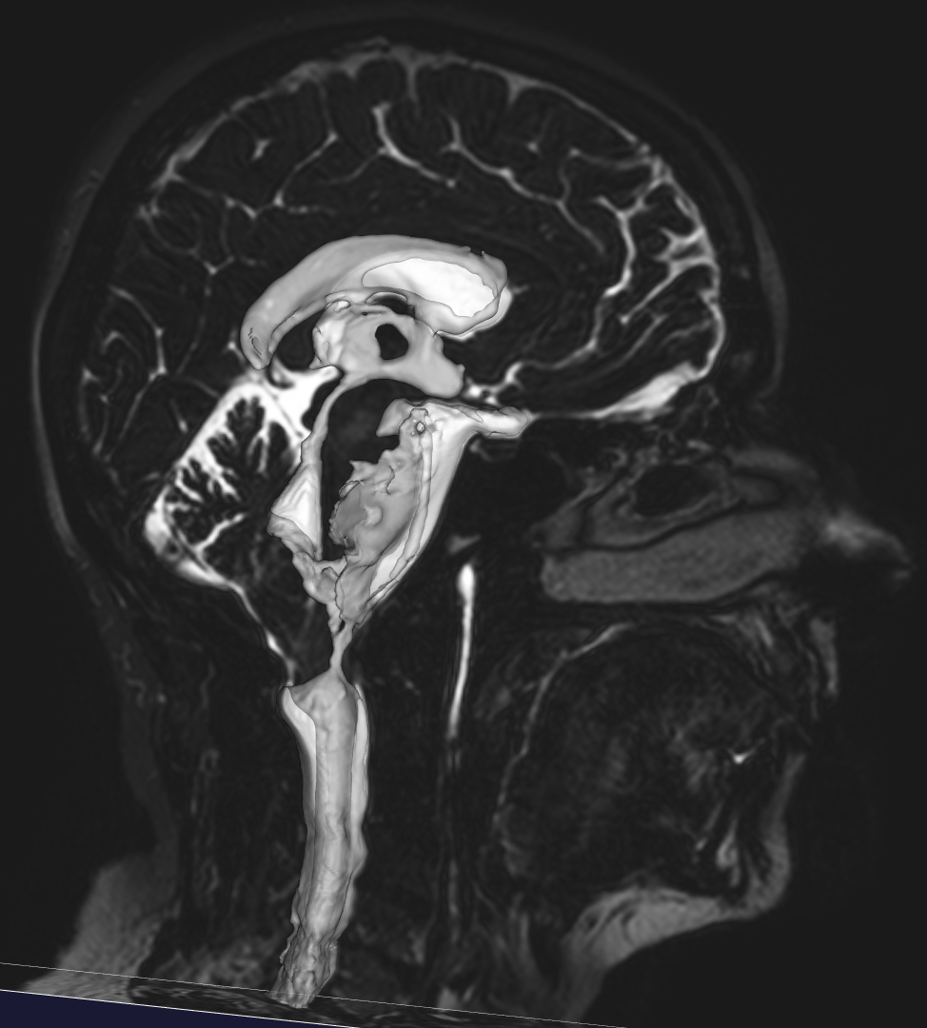
We reconstruct the SAS and ventricles from MR-images using the level set method (VMTK)
Volunteer
Patient

Slide 6
The Cerebrospinal fluid flow is ´hyperkinetic´-- with abnormally high velocities and pressure gradients
Cerebrospinal fluid is basically water
(and so is the extra-cellular fluid)
Reynolds number ~ 100-500
Womersly number ~ 1-5
Structures of mm scale
The complete compartment is around 1m long
Around 1 cm^3 flows up and down per second
Driven by the pulsation of brain, arteries and veins
Interacts with tissue – rigid motion, deformation and porous media flow

Slide 7
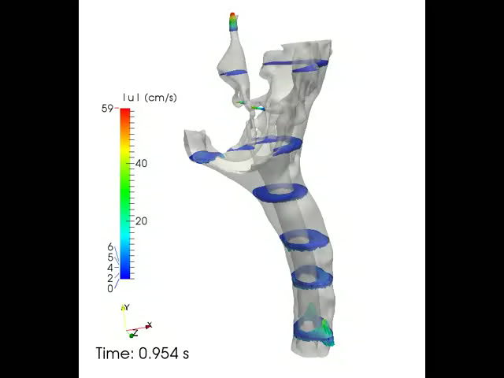
We simulated pulsatile flow through the 4th ventricle and CSF space in one control and two Chiari patients
By Karen Støverud
Control
Notes:
Here you see the velocity at different cross-section in the control patient. In general the flow is quite uniform –apart from in the aqueduct.
We also see that the duration of downwards directed flow, that is systole, is shorter with higher magnitude than upwards directed flow, that is diastole.

Slide 8
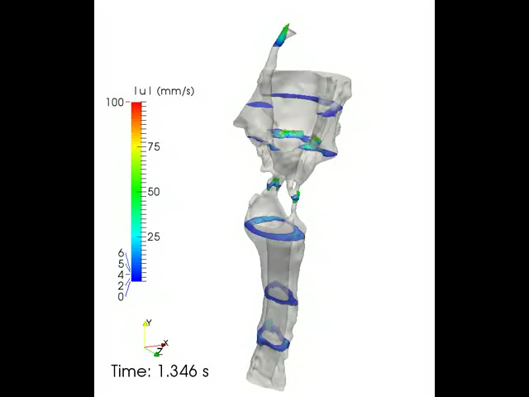
We simulated pulsatile flow through the 4th ventricle and CSF space in one control and two Chiari patients
By Karen Støverud
Patient with severe Chiari malformation
Notes:
Here you see the velocity pattern in the patient with the most severe obstruction. The flow pattern is now more complex with large flow jets extending well below and above the narrow channels connecting the cranial and cervical CSF space.

Slide 9
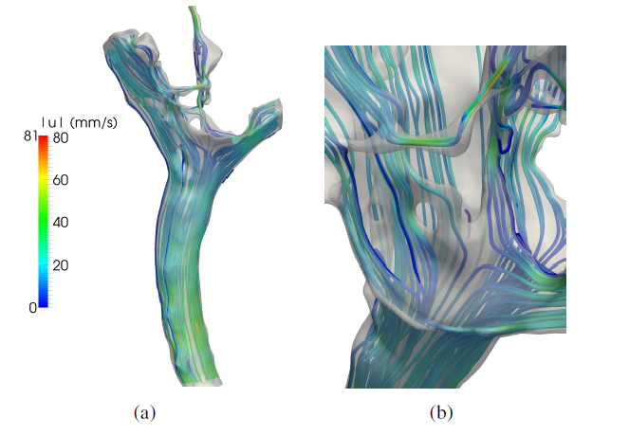
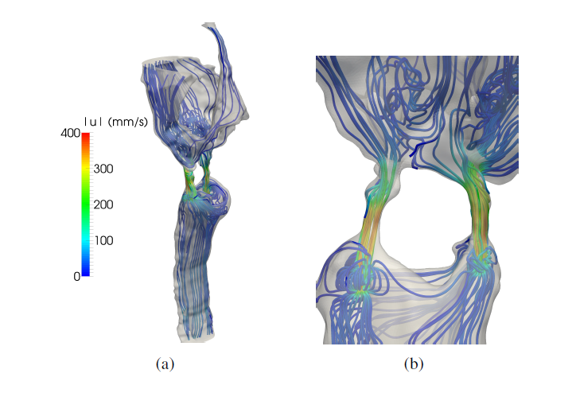
Main results from CFD simulations
Healthy
Pressure drop : 2-3 as high in Chiari patients
Velocities were up to 15 times higher
Flux almost the same
Phase difference between patients and normals
Not healthy

Slide 10
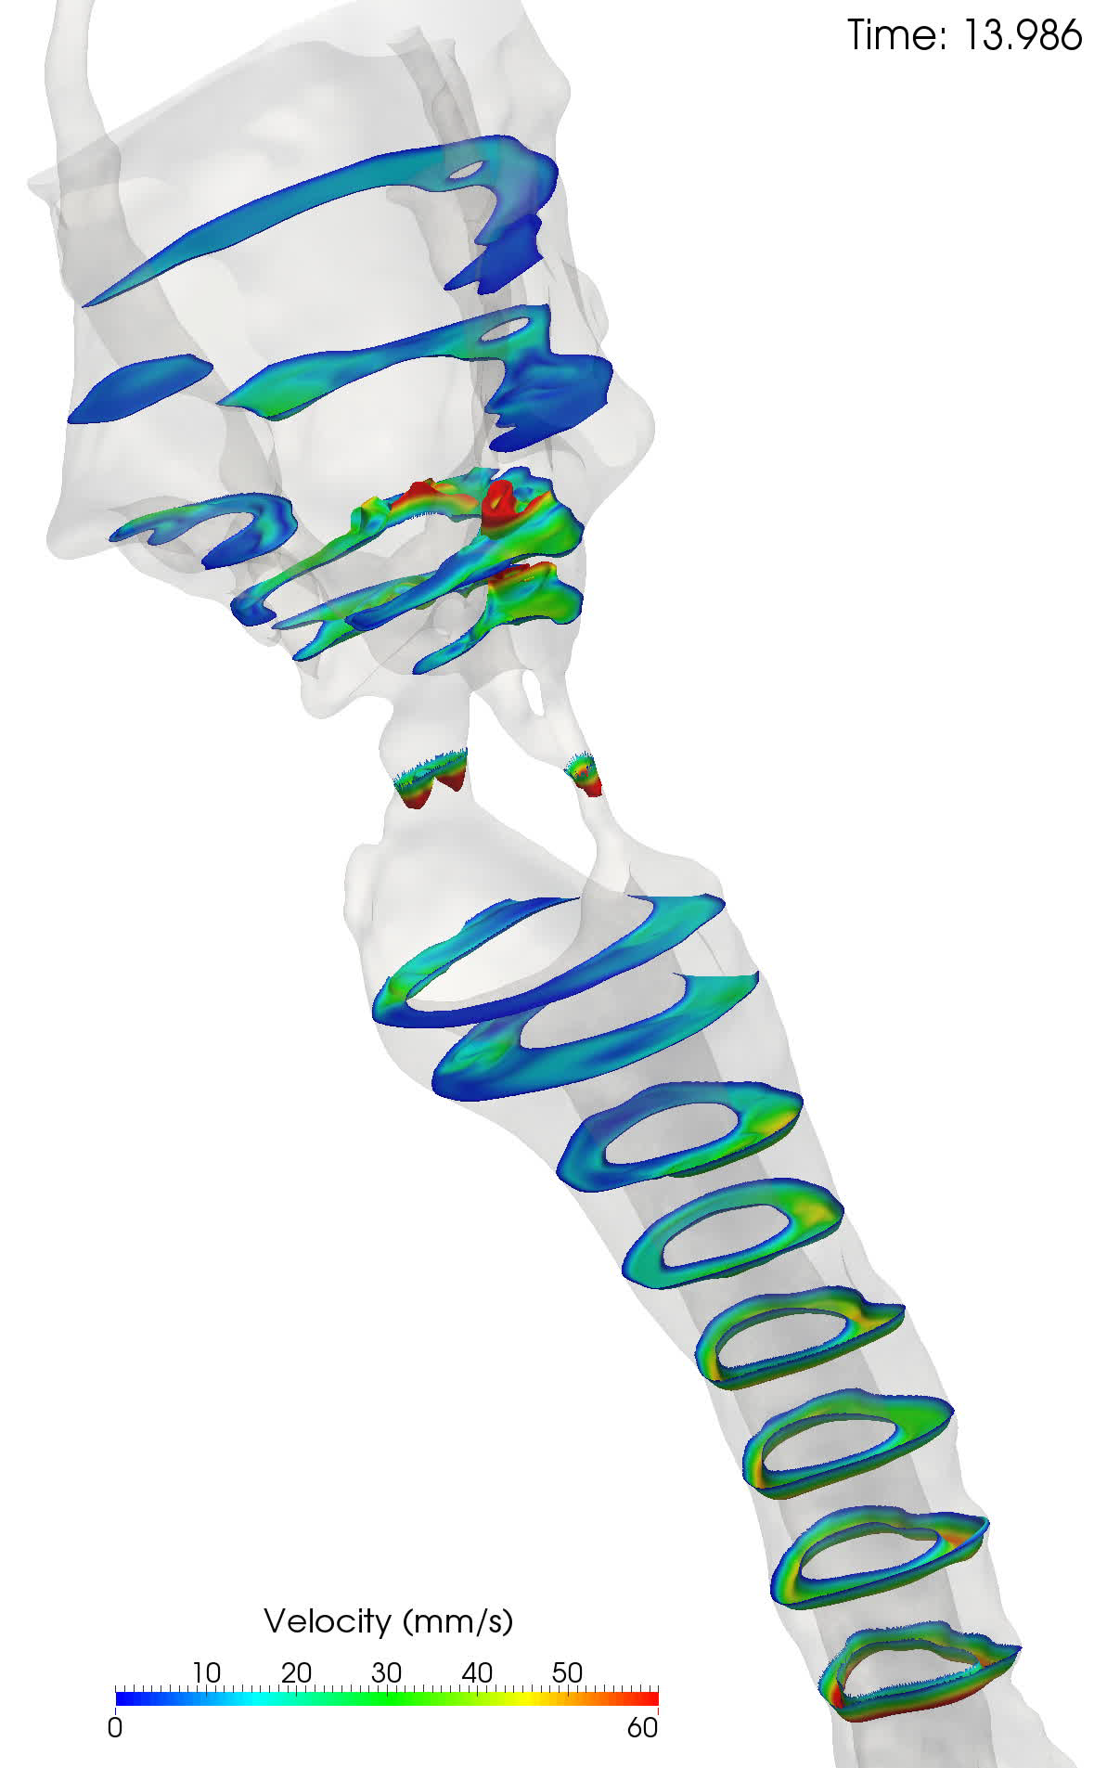
LBM simulations

Slide 11
Lattice-Boltzmann solver (Kartik Jain)
Simulations conducted using the APES^{1,2} simulation framework
End-to-end parallel simulation tool chain
Seeder - Mesh Generator
Musubi – Lattice Boltzmann Solver
Ateles – Discontinuous Galerkin method based solver for conservation equations
Harvester – Post processor
Models discretized with cubical mesh of
∂x = 32µm (l+ around 0.9)
∂t = 20µs (t+ less than 0.1)
Resulted in ~ 800 million cells for each model
Simulations conducted on the SuperMUC petascale system in Munich using 12000 cores
Computing 25 cardiac cycles required approximately 12 hours of execution time for each model
“Coarse” simulation on 48µm revealed error of 5-8%
¹Roller, Sabine, et al. "An adaptable simulation framework based on a linearized octree." High Performance Computing on Vector Systems 2011. Springer Berlin Heidelberg, 2012. 93-105.
²Klimach, Harald, Kartik Jain, and Sabine Roller. "End-to-end Parallel Simulations with APES.”

Slide 12
Further reading
Jain, Kartik, et al. "Direct numerical simulation of transitional hydrodynamics of the cerebrospinal fluid in Chiari I malformation: The role of cranio‐vertebral junction." International journal for numerical methods in biomedical engineering 33.9 (2017): e02853.
Støverud, Karen-Helene, et al. "Computational investigation of cerebrospinal fluid dynamics in the posterior cranial fossa and cervical subarachnoid space in patients with Chiari I malformation." PloS one 11.10 (2016): e0162938.

